Slide 1

Jason Douangsanith
Long Ngo
Connor Ladd
Ramin Jabbari

Slide 2
PREDICTING THE WINNER OF THE WORLD CUP

Slide 3
THERE ARE SEVERAL WAYS TO PREDICT THE WINNER…

Slide 4

METHOD 1: GUESSING

Slide 5


GO ENGLAND!

Slide 6

METHOD 2: USING THE WISDOM OF THE CROWDS

Slide 7
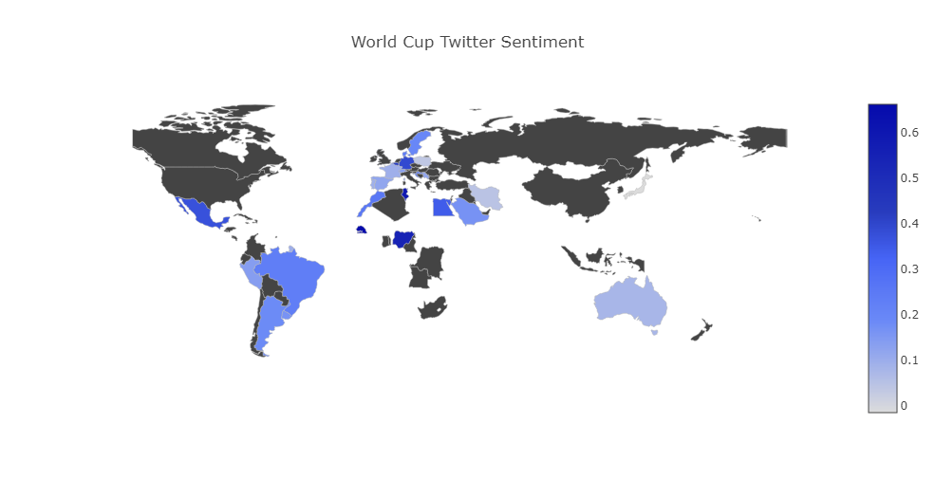
Who Does Twitter Think Will Win? Heat Map Of Sentiment For WC Teams

Slide 8
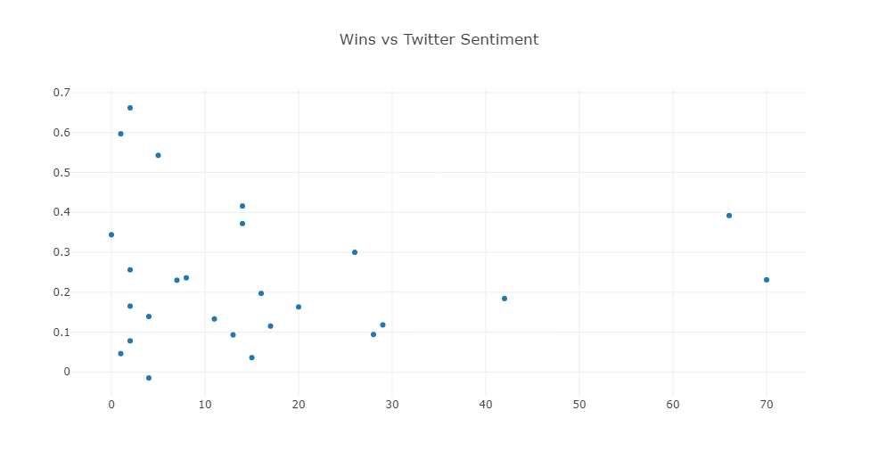


Twitter Loves The Underdogs

Slide 9

METHOD 3: ANALYZING PAST WORLD CUPS

Slide 10
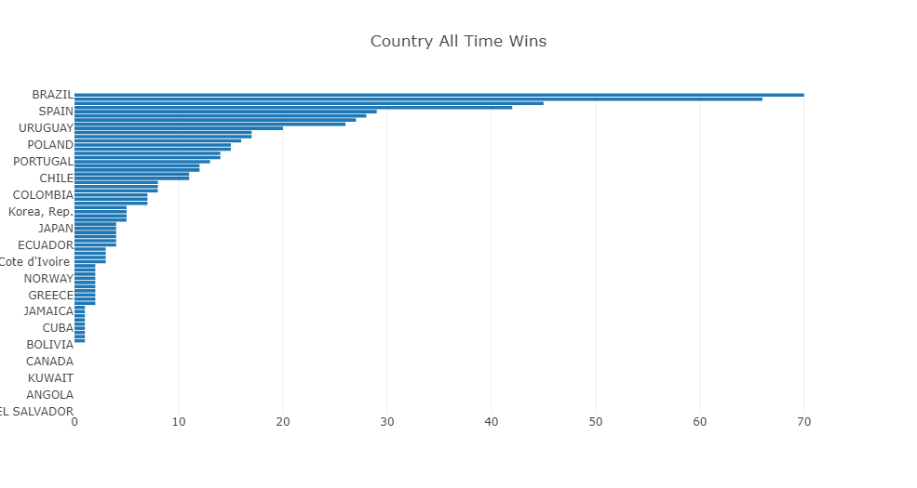
Which teams have won the most in World Cups of the past?

Slide 11
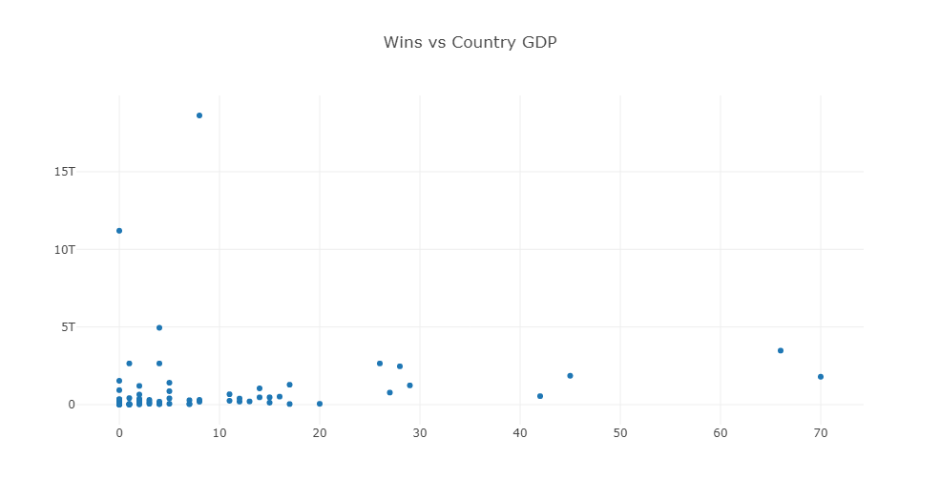


Is it the richest countries that win?

Slide 12
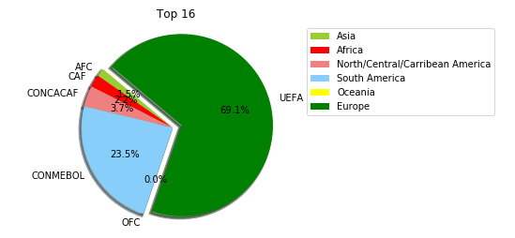
How The Different World Conferences Have Qualified Through The World Cup In The Past
Round Of 16

Slide 13
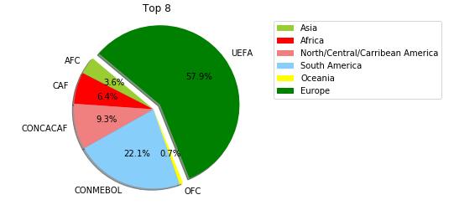
How The Different World Conferences Have Qualified Through The World Cup In The Past
Round Of 8

Slide 14
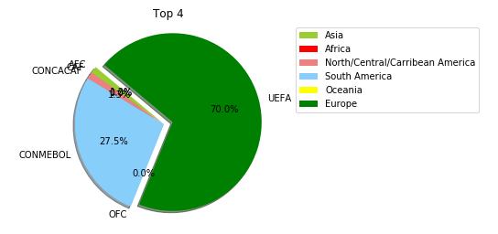
How The Different World Conferences Have Qualfied Through The World Cup In The Past
Round Of 4

Slide 15
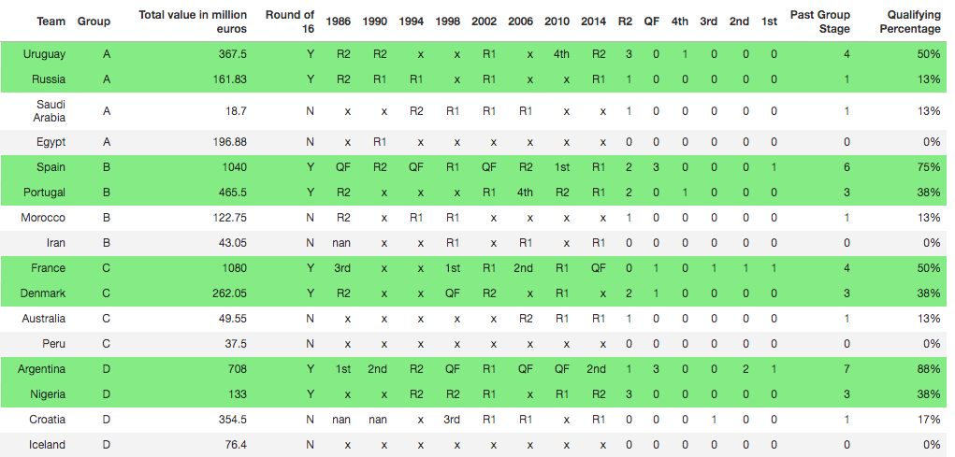
Percentage of Qualifications Past Group Stage For Each Team (1986-2014)

Slide 16
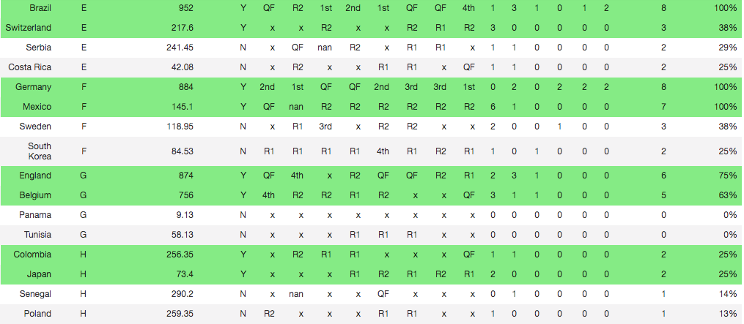
Percentage of Qualifications Past Group Stage For Each Team (1986-2014)

Slide 17
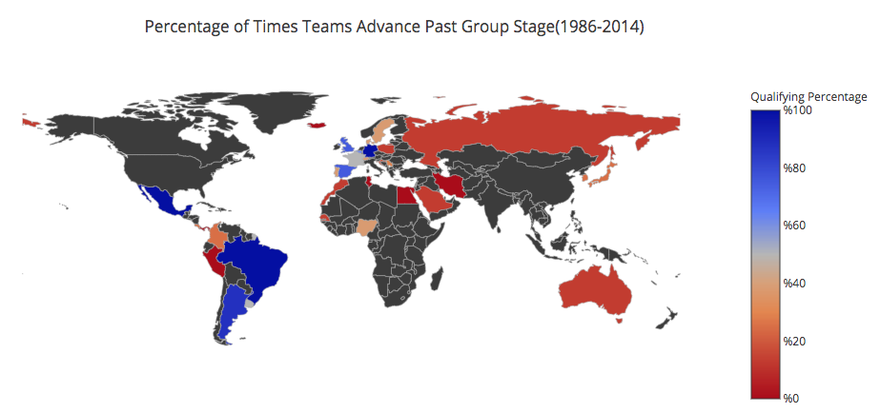
Heat Map of Teams Advancing Past the Group Stage

Slide 18
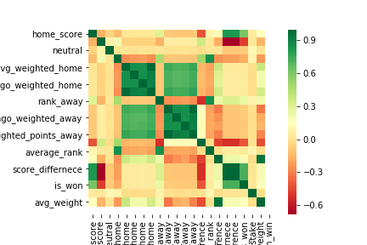
What Factors Positively Correlated With Success
INSERT CORRELATION ANALYSIS MATRIX

Slide 19
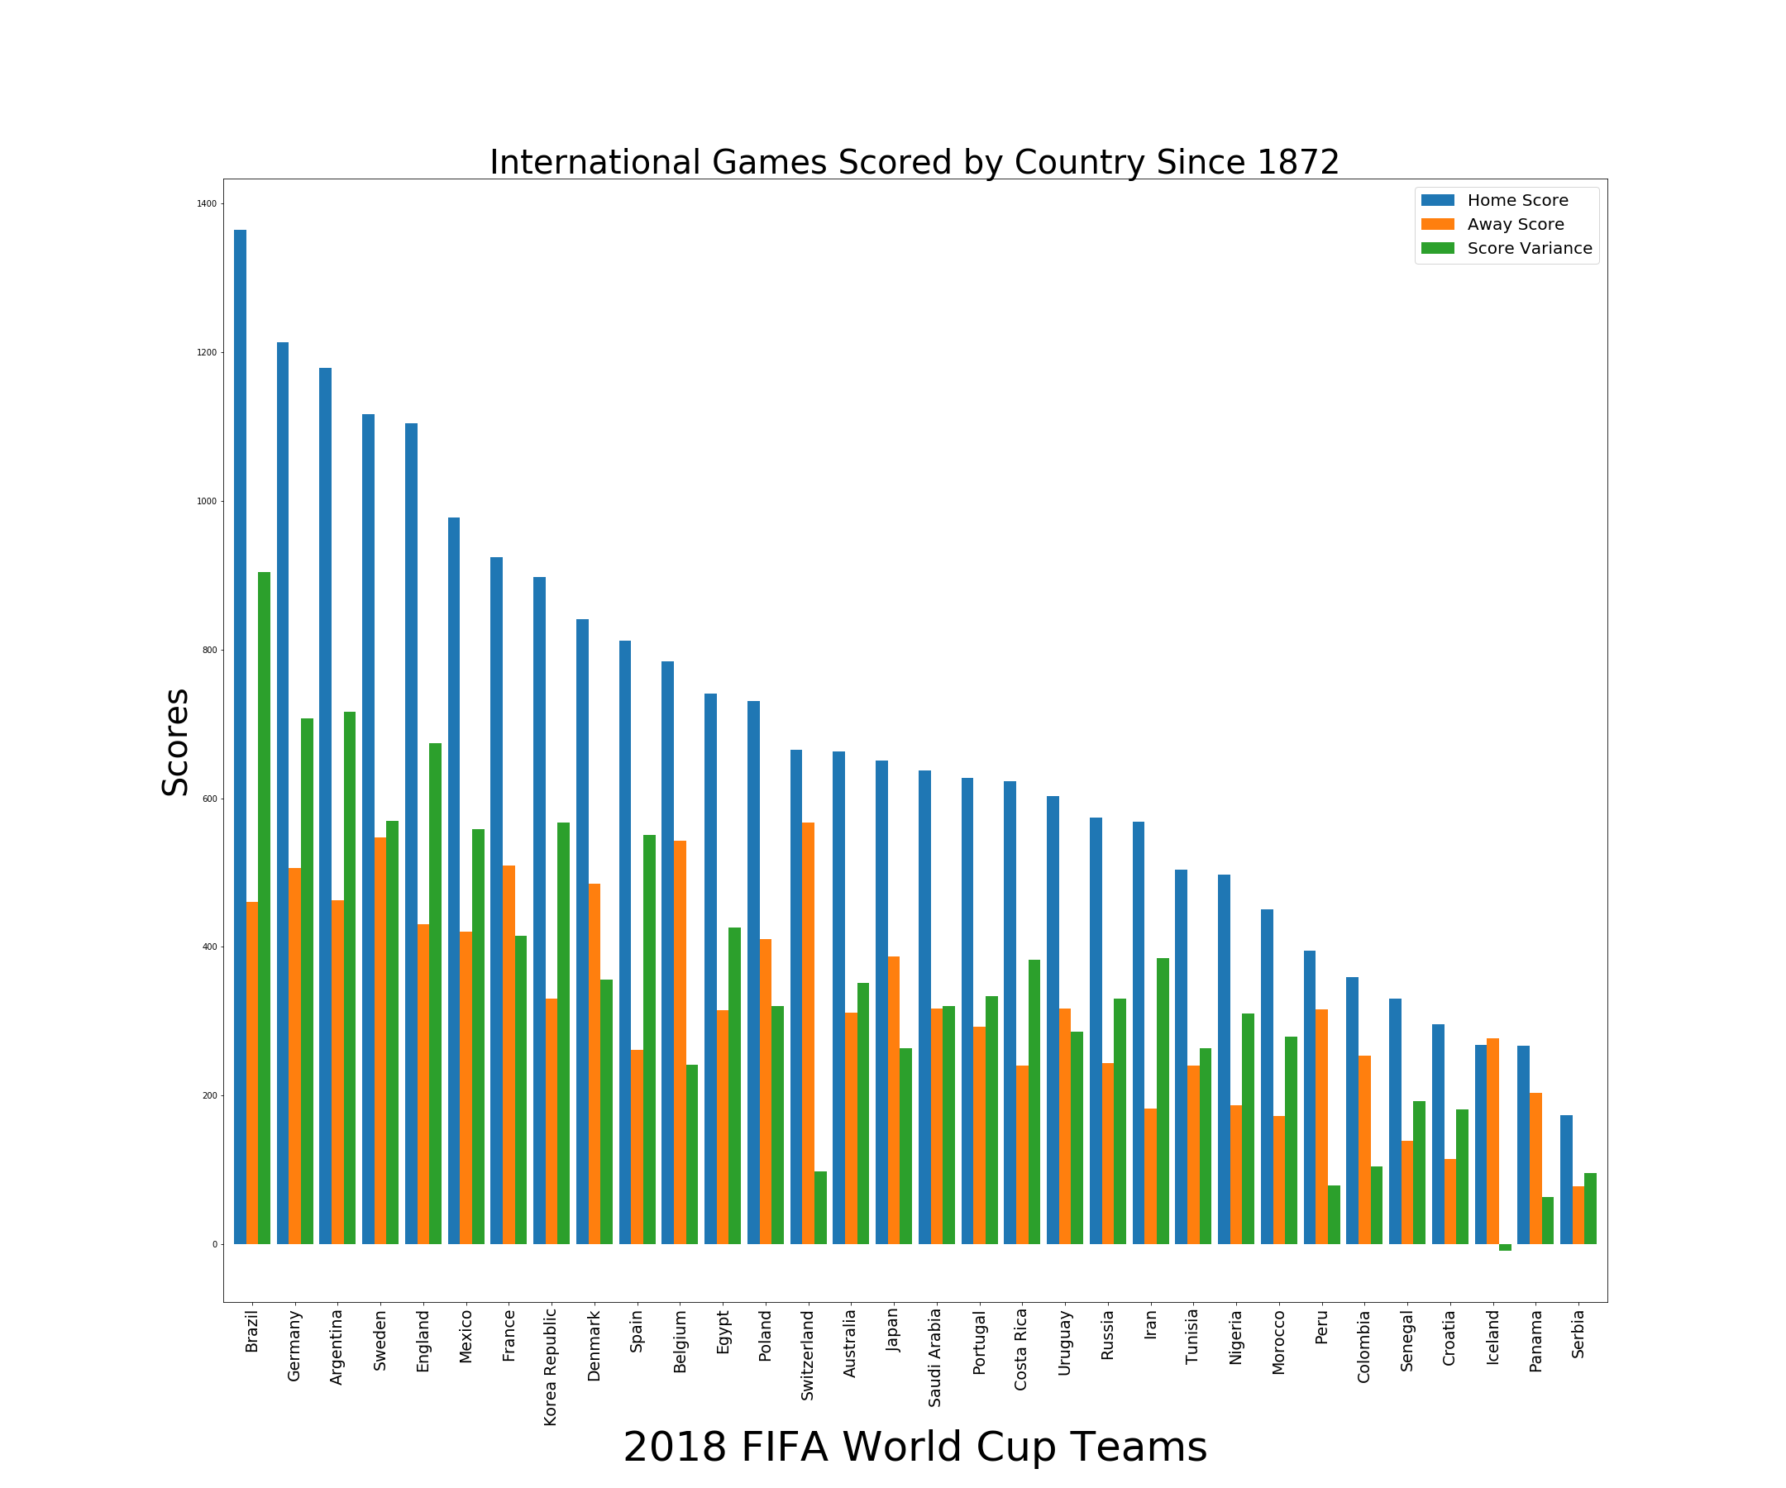
Who are the Highest Scoring Teams of All Time

Slide 20
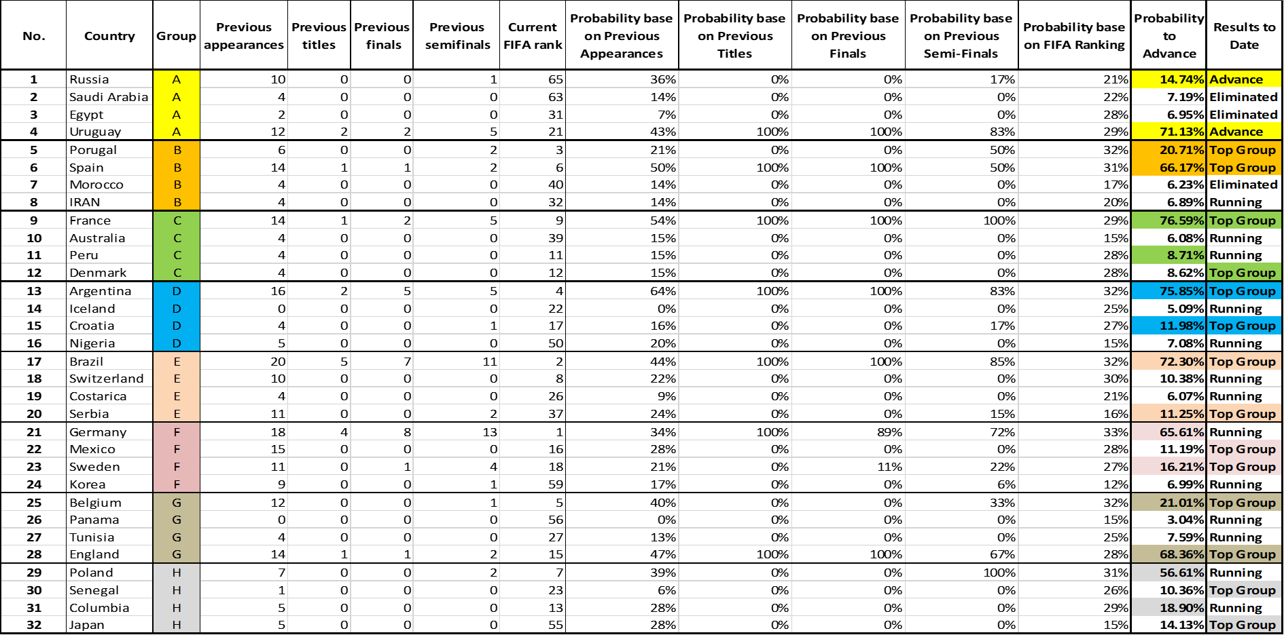

Slide 21
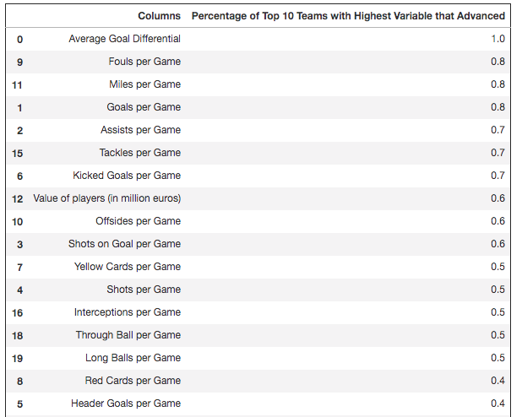
What Factors Most Contributed With Success At The Last WC 2014

Slide 22
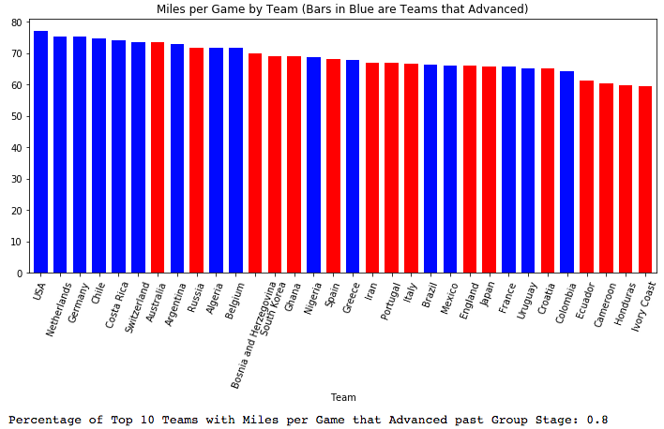
What Factors Most Contributed With Success At The Last WC 2014

Slide 23
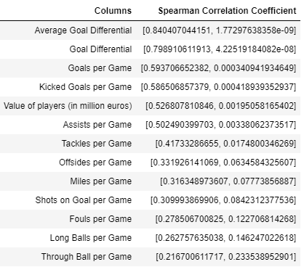
What Factors Most Contributed With Success At The Last WC 2014

Slide 24
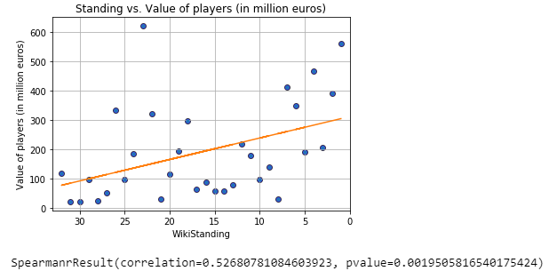
Value Of Players 2014

Slide 25
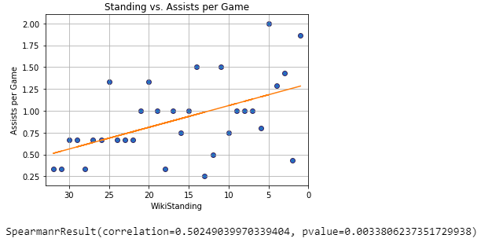
Assists Per Game 2014

Slide 26
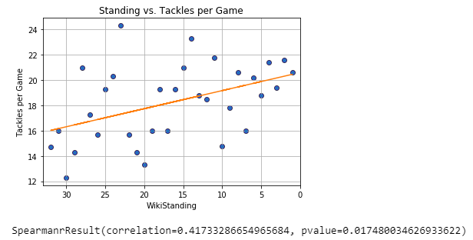
Tackles Per Game 2014

Slide 27
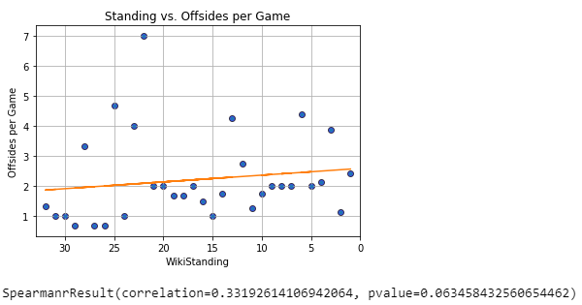
Offsides Per Game 2014

Slide 28
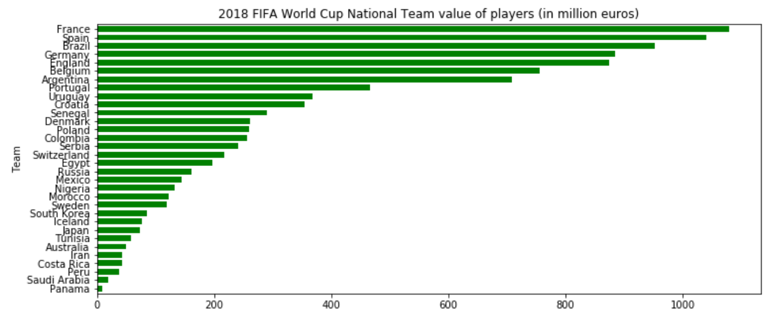

Based On The Average Value Of Players In 2018 We Think The Winner Will Be…..

Slide 29

METHOD 4: MACHINE LEARNING

Slide 30
Machine Learning-Supervised
Supervised learning that maps an input to an output based on example input-output pairs.
Data Sets used
Historical data of all International Soccer competitions
FIFA ranking of each country
Current WC Competition information

Slide 31
Goals
Test the different types of model
Using two different sets of training and testing data
First, has a y that is categorical
Second, has a y that is numerical
Models used
Linear Regression
Lasso
Ridge
Logistic Regression
Set model to predict WC

Slide 32
Feature Engineering-Desired Variables
df['rank_difference'] = df['rank_home'] - df['rank_away']
df['average_rank'] = (df['rank_home'] + df['rank_away']) / 2
df['point_difference'] = df['weighted_points_home'] - df['weighted_points_away']
df['score_difference'] = df['home_score'] - df['away_score']
df['is_won'] = df['score_difference'] > 0
df['avg_weight'] = (df['cur_year_avg_weighted_home'] - df['cur_year_avg_weighted_away'])
df['is_stake'] = df['tournament'] != 'Friendly’
First Set = X, Dependent(average_rank, rank_difference, avg_weight,), Y, Independent (point_difference)
Second Set = X, Dependent(average_rank, rank_difference, point_difference, is_stake) Y, independent (is_won)

Slide 33
Linear Regression
First Set
R^2: 0.9154184661398009
Root Mean Squared Error: 42.40478853408971
Average 3-Fold CV Score: -0.0005854434393655072
Average 5-Fold CV Score: 0.363855096420143
Average 10-Fold CV Score: 0.27491891175679484
Second Set
R^2: 0.17774830121027307
Root Mean Squared Error: 0.45299245868344784
Average 3-Fold CV Score: 0.17165039543170943
Average 5-Fold CV Score: 0.17170279127554944
Average 10-Fold CV Score: 0.17153506249619058

Slide 34
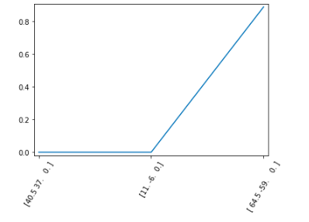
Lasso
First Set
Lasso_coef - [-0. -0. 0.88956927]
Lasso score: 0.830079301939818

Slide 35
Lasso
Lasso: Along with shrinking coefficients, lasso performs feature selection as well. Some of the coefficients become exactly zero, which is equivalent to the particular feature being excluded from the model.
Lasso: Since it provides sparse solutions, it is generally the model of choice (or some variant of this concept) for modelling cases where the #features are in millions or more. In such a case, getting a sparse solution is of great computational advantage as the features with zero coefficients can simply be ignored
Lasso: It arbitrarily selects any one feature among the highly correlated ones and reduced the coefficients of the rest to zero. Also, the chosen variable changes randomly with change in model parameters. This generally doesn’t work that well as compared to ridge regression.

Slide 36
Ridge
Ridge: It includes all (or none) of the features in the model. Thus, the major advantage of ridge regression is coefficient shrinkage and reducing model complexity.
Ridge: It is majorly used to prevent overfitting. Since it includes all the features, it is not very useful in case of exorbitantly high #features, say in millions, as it will pose computational challenges.
Ridge: It generally works well even in presence of highly correlated features as it will include all of them in the model but the coefficients will be distributed among them depending on the correlation.

Slide 37
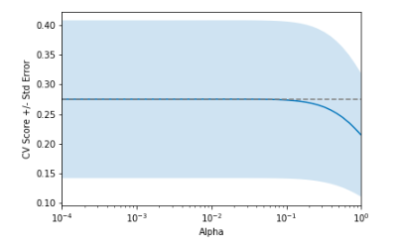
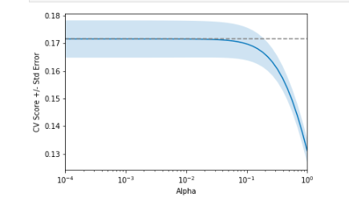
Ridge
First Set
Second Set

Slide 38
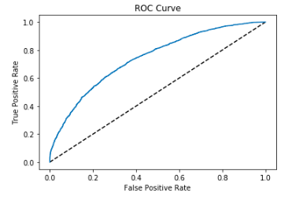
ROC Curve
An ROC curve is the most commonly used way to visualize the performance of a binary classifier, and AUC is (arguably) the best way to summarize its performance in a single number
The larger the area under the curve the better the model
AUC: 0.7412463304613475
AUC scores computed using 5-fold cross-validation: [0.73847596 0.7391744 0.76112723 0.72931592 0.73220781]

Slide 39
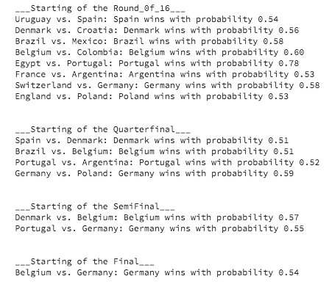
Logistic Regression

Slide 40
Germany!

Slide 41
FINAL PREDICTIONS

Slide 42
SUMMARY
1) There is a lot of positive sentiment around underdog teams on Twitter.
2) The richest countries aren’t the most successful.
3) Value of players is a good indicator of success.
4) Historically teams from Europe and South American conferences have tended to advance past group stages than other parts of the world.
5) Predicting the winners of any game is difficult with numerous unknown variables

